Slide 1
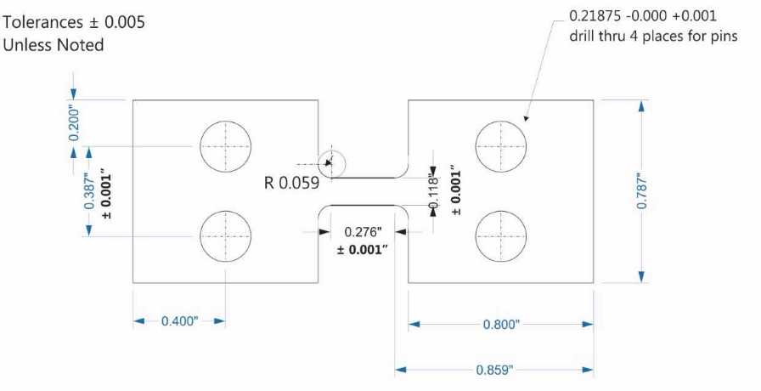
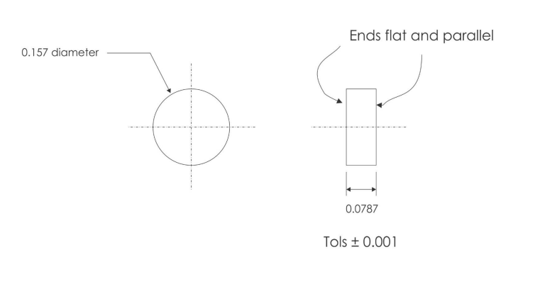
NIST SURF Program Final Presentation
Tension Specimen
Compression Specimen
A Study of Inconel 625 in both Tension and Compression at High Strain Rates using a Pulse-Heated Split Hopkinson Bar
Author: Charlie Nitschelm
Mentor: Steven Mates

Slide 2
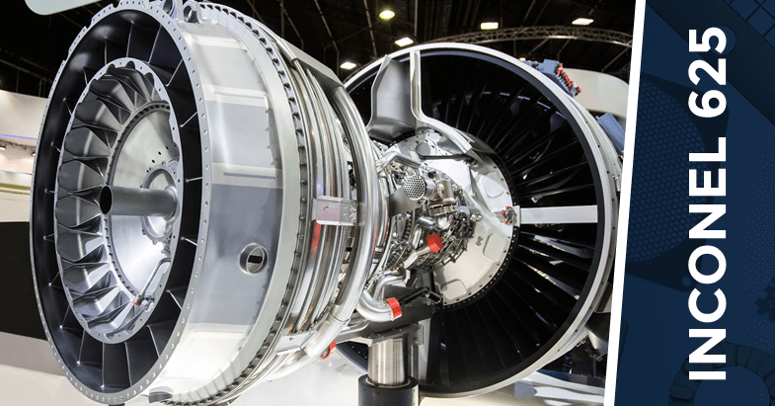
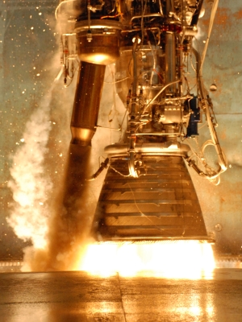
Why Inconel 625? What are the Applications
What it is: Small amounts of niobium combine with nickel to form intermetallic compounds. These compounds form small cubic crystals that inhibit slip and creep effectively at elevated temperatures. Inconel is known as a superalloy.
Why is it useful?
High strength-to-weight ratio
The capabilities of the material as sheet metal
Oxidation and corrosion resistant
Great in high pressure and temperature environments
More resistant to creep than its competitors

Slide 3
Abstract
This project focuses on the mechanical behavior of Inconel 625 (IN625) at various temperatures and strain rates.
To better understand how the material behaves during dynamic metal forming processes, which is at high strain rates and temperatures.
The degradation of mechanical properties near 700 °C may involve the gradual growth of brittle carbides or precipitates,
Brittle carbides and precipitates introduce the possibility that the strength of IN625 is time-dependent under dynamic forming conditions, where heating times are short and strain rates are high.
The data is then used to calibrate the Johnson-Cook flow stress model, which can accurately capture strain hardening, strain-rate hardening and thermal softening in many metal alloys.
The calibrated model will then be used to simulate the dynamic forming of laminate components for a heat exchanger to allow electricity to be created from high temperature waste heat from industrial exhaust which currently adds up to 2.4 million kWh (or 8,000,000,000 gallons of gasoline)

Slide 4
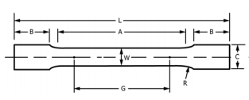
NIST IN625 Tension Specimen vs ASTM E8 Standard
NIST Tension Specimen
ASTM Standard Tension Specimen
1. Specimen uses the full thickness of sheet for a .5 mm thickness
1. Requires the specimen to use the entire thickness of the sheet metal
2. The gage length is designed to 7 mm because of the limitations of the applied force and displacement of the Kolsky Bar
2. Requires a minimum gage length (G) of 32 mm for each specimen
3. The Gage length to gage width ratio is 4:3
3. Gage length to gage width ratio of at least 4:1
4. Ensures a strain of ~.35 for each test, assisting with the likelihood of capturing fracture
4. If all suggestions are applied to the NIST Tension Specimen for the Kolsky Bar, a strain of .11 would be achieved.

Slide 5
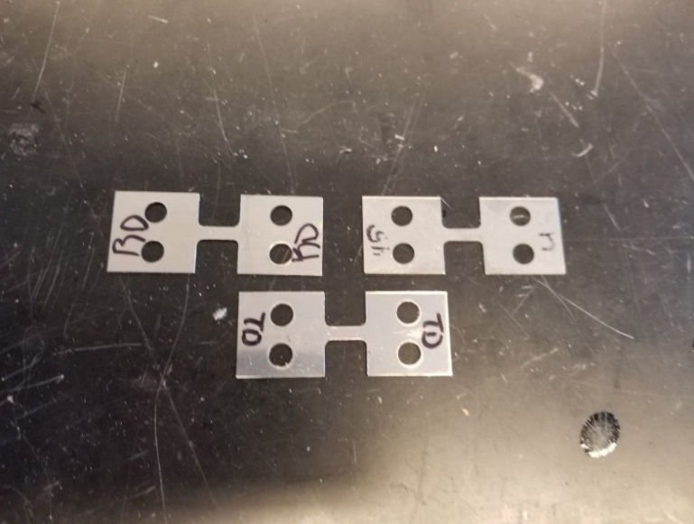
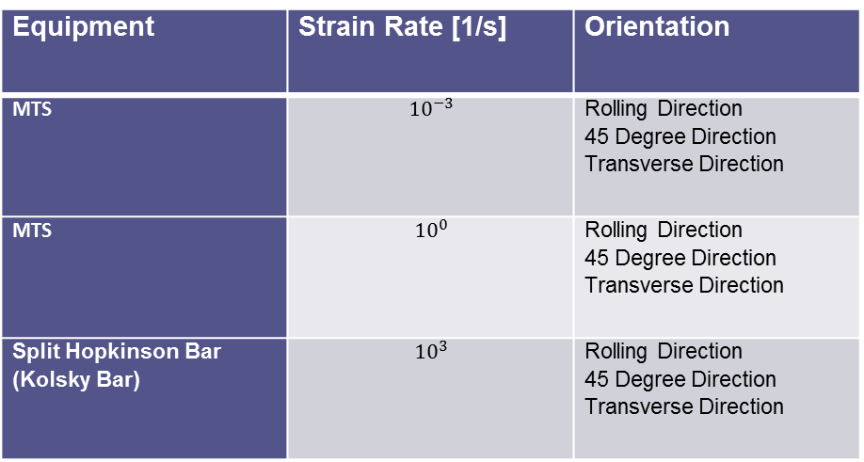
What are we testing
Two different tension machines must be used to obtain the desired strain rates. One is the typical MTS machine that can do very low strain rates. The other is the Kolsky Bar, which is designed to handle very high strain rates.
Equipment | Strain Rate [1/s] | Orientation
MTS | $${10}^{−3}$$ | Rolling Direction 45 Degree Direction Transverse Direction
MTS | $${10}^{0}$$ | Rolling Direction 45 Degree Direction Transverse Direction
Split Hopkinson Bar (Kolsky Bar) | $${10}^{3}$$ | Rolling Direction 45 Degree Direction Transverse Direction
IN 625 sheets come with a specific direction of rolling to form it to its given dimensions. To understand the mechanical difference of its rolling direction, different orientations of the material had to be tested at various strain rates.

Slide 6
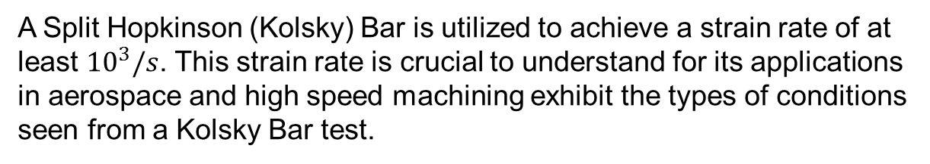
Testing Conditions – High Strain Rate
Picture of Kolsky Bar
! !
!
!
! !
!
A Split Hopkinson (Kolsky) Bar is utilized to achieve a strain rate of at least ${10}^{3}/s$. This strain rate is crucial to understand for its applications in aerospace and high speed machining exhibit the types of conditions seen from a Kolsky Bar test.

Slide 7
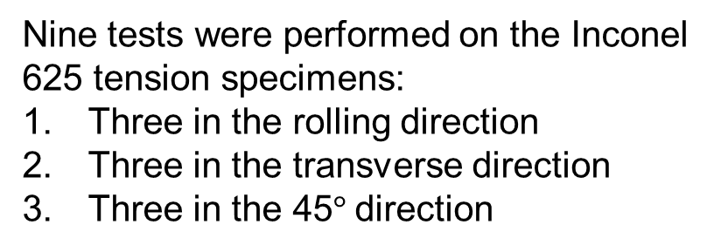
High Strain Rate Tests
Nine tests were performed on the Inconel 625 tension specimens:
Three in the rolling direction
Three in the transverse direction
Three in the 45$°$direction

Slide 8
High Strain Rate Test Results

Slide 9
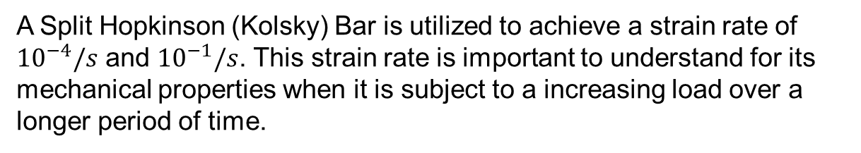
Testing Conditions – Low Strain Rates
Picture of MTS
! !
!
!
! !
!
A Split Hopkinson (Kolsky) Bar is utilized to achieve a strain rate of ${10}^{−4}/s$ and ${10}^{−1}/s$. This strain rate is important to understand for its mechanical properties when it is subject to a increasing load over a longer period of time.

Slide 10
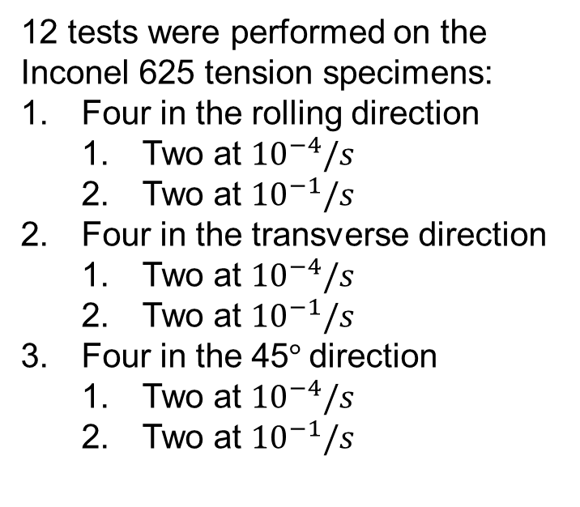
Low Strain Rate Tests
12 tests were performed on the Inconel 625 tension specimens:
Four in the rolling direction
Two at ${10}^{−4}/s$
Two at ${10}^{−1}/s$
Four in the transverse direction
Two at ${10}^{−4}/s$
Two at ${10}^{−1}/s$
Four in the 45$°$direction
Two at ${10}^{−4}/s$
Two at ${10}^{−1}/s$

Slide 11
Low Strain Rate Test Results -${ 10}^{−1}/s$

Slide 12
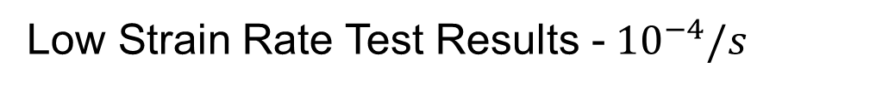
Low Strain Rate Test Results -${ 10}^{−4}/s$

Slide 13
Low Strain Rate Test Results - ${10}^{−1}/s$ and ${10}^{−4}/s$

Slide 14
Rolling Direction at all Strain Rates

Slide 15
Transverse Direction at all Strain Rates

Slide 16
45$°$ Direction at all Strain Rates

Slide 17

Peer Verification – ${ 10}^{−1}/s$ Strain Rate

Slide 19
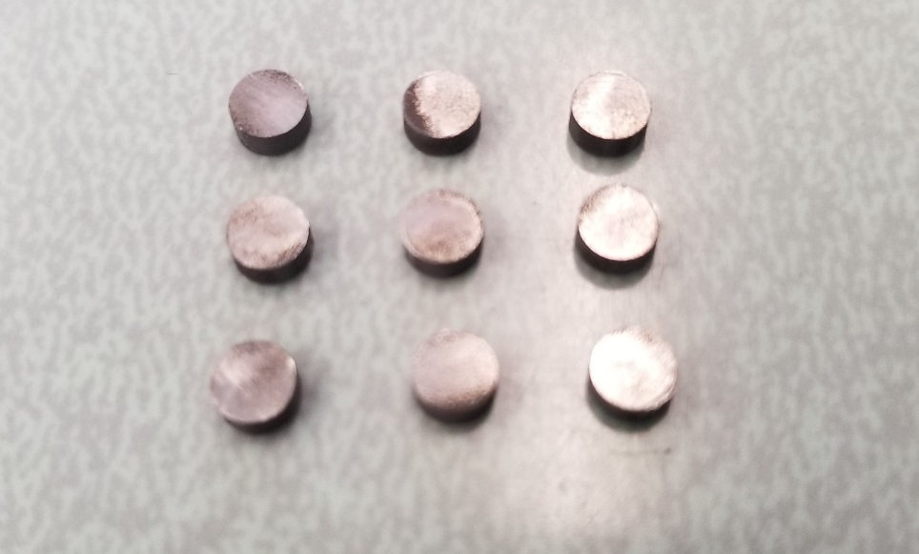
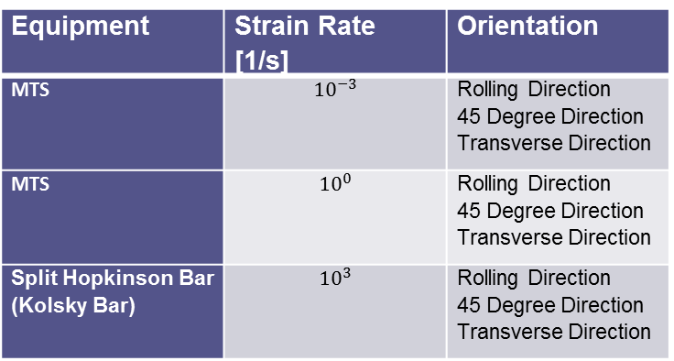
IN 625 Compression Specimens
The IN 625 compression tests will be used to probe the deformation mechanics to derive the parameters of the Johnson-Cook equation to better design systems using the material.
Inconel plates come with a specific direction of rolling to form it to its given dimensions. To understand the mechanical difference, different orientations of the IN 625 must be tested at various strain rates.
Equipment | Strain Rate [1/s] | Orientation
MTS | $${10}^{−3}$$ | Rolling Direction 45 Degree Direction Transverse Direction
MTS | $${10}^{0}$$ | Rolling Direction 45 Degree Direction Transverse Direction
Split Hopkinson Bar (Kolsky Bar) | $${10}^{3}$$ | Rolling Direction 45 Degree Direction Transverse Direction

Slide 20
Testing Conditions – High Strain Rate
Picture of Kolsky Bar
! !
!
!
! !
!
A Split Hopkinson (Kolsky) Bar is utilized to achieve a strain rate of at least ${10}^{3}/s$. This strain rate is crucial to understand for its applications in aerospace and high speed machining exhibit the types of conditions seen from a Kolsky Bar test.

Slide 21
High Strain Rate Tests
Nine tests were performed on the Inconel 625 tension specimens:
Three in the rolling direction
Three in the transverse direction
Three in the 45$°$direction

Slide 22
High Strain Rate Test Results

Slide 23
Johnson-Cook Model

